Slide 1
INDIAN ASTRONOMY
Department of oriental studies & research, sastra university
Author : Dr. S. Balachandra Rao
Paper by Uthra Chandhiramouli

Slide 2
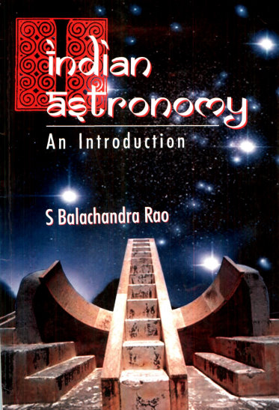
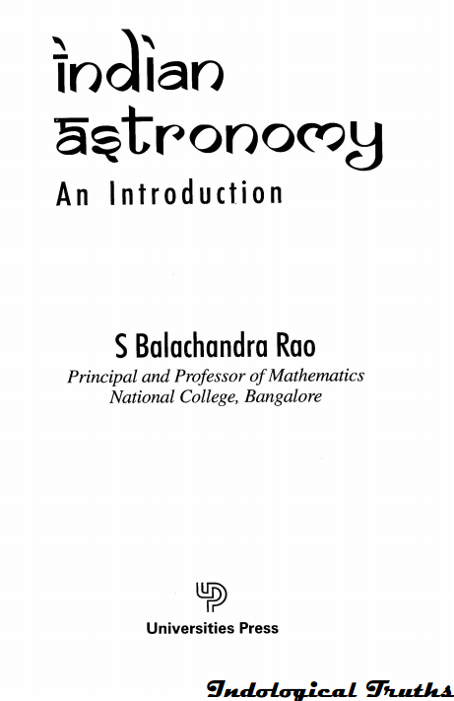
SOURCE

Slide 3
CHAPTER 1 HISTORICAL INTRODUCTION
यथा शिखा मयूराणां, नागानां मणयो यथा।
तद्वद् वेदाङ्गशास्त्राणां, गणितं मूर्धनि स्थितम् ॥
“Like the crests on the heads of peacocks, like the gems on the hoods of the cobras, Jyotisha (Astronomy) is at the top of the Vedanga sastras—the auxiliary branches of Vedic knowledge”.Vedangajyotisha

Slide 4
ANCIENT INDIAN ASTRONOMY
THE SIX VEDANGAS
1. Siksha (phonetics)
2. Vyakarana (grammar)
3. Chandas (metrics)
4. Nirukta (etymology)
5. Jyotisha (astronomy)
6. Kalpa (rituals)

Slide 5
VEDANGA JYOTISHA
Vedanga Jyotisha is the earliest Indian astronomical text available.
The Vedanga Jyotisha was mainly to fix suitable time for performing the different sacrifices.
The text is found in two recensions – Rgveda Jyotisha (36 verses) and Yajurveda Jyotisha (44 verses).
The Vedanga Jyotisha is attributed to Sage Lagadha.
The accepted period of Vedanga Jyotisha is between 12th and 14th centuries B.C.
It belongs to the last part of the Vedic age.

Slide 6
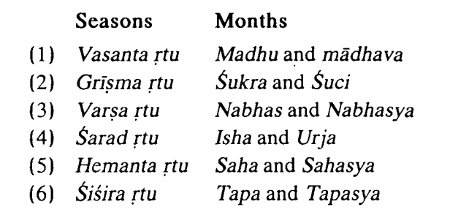
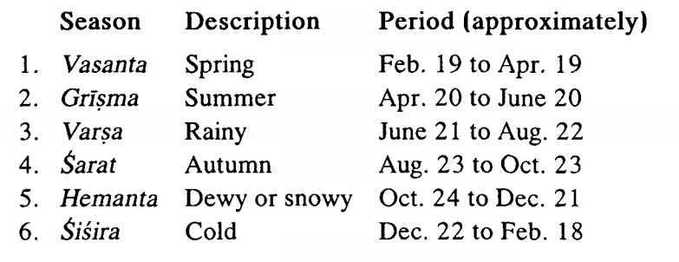
In Yajurveda, a year comprising 12 solar months and 6 rtus(seasons) was recognised. The Taittiriya Samhita gives the names of the solar months connected with the different seasons as follows:
Note:
The Phalguna Amavasya marks the last day of the year and the Prathama following the Phalguna Amavasya is the first day of the year for the Chandramana calendar.
The day when Surya enters the Mesha masa will be the beginning of the year for Sauramana calendar.
The gap between the 2 calendars will be approximately 2 weeks.

Slide 7
The Vedic astronomers evolved a system of five years’ yuga. The names of the five years of a yuga are:
Samvatsara
Parivatsara
Idavatsara
Anuvatsara, and
Idvatsara.
This period of a yuga (of 5 years) was used to calculate time as can be seen from statements like, “Dirghatamas, son of Mamata, became old even in his tenth yuga”, i.e., between the age of 45 and 50 years(Rgveda. 1.158.6).

Slide 8
Vedanga Jyotisha contains various calendrical items prevalent during those times like :
The solstices (अयनान्त)
Increase and decrease of the durations of days and nights in the ayanas.(उत्तरायण, दक्षिणायन)
The solstitial tithis (अयनतिथि)
The seasons (ऋतु)
Omission of tithis (शून्य दोष)
Table of parvas
Yogas
Finding the parva nakshatra and the parva tithis
The equinoxes (विषुवत्)
The solar year (वर्ष) and other types of years
The revolutions of the sun and the moon (as seen from the earth) (सूर्यपरिभ्रम, चन्द्रपरिभ्रम)
The times of the sun’s and the moon’s transit through a nakshatra
The intercalary month (अधिकमास)
The measures of the longest day and the shortest day, etc.

Slide 9
SIDDHANTAS
Around the beginning of the Christian era, a new class of Indian astronomical literature emerged. The texts representing this development are called Siddhanta.
These Siddhanta texts contain much more material and topics than the Vedanga Jyotisha.
Along with the nakshatra system, the 12 signs of the zodiac viz., Mesa, Vrsabha etc., were introduced.
Computations of the motions of the planets, solar and lunar eclipses, ideas of parallax etc formed the common contents of the siddhantic texts.
According to the Indian tradition, there were principally 18 siddantas : Surya, Paitamaha, Vyasa, Vasishta, Atri, Parasara, Kasyapa, Narada, Gargya, Marici, Manu, Angira, Lomasa, Paulisa, Cyavana, Yavana, Bhrgu and Saunaka. Among these, only 5 siddantas were extant during the time of Varahamihira and he ably collected together these five tor his Pancasiddhantika

Slide 10
ARYABHATTA 1(476 AD)
Aryabhatta composed Aryabhatiyam when he was 23 years old
Aryabhatiyam consists of 4 parts(padas) viz., Gitika, Ganita, Kãlakriya and Gola
Gitika pada consists of 13 verses and introduces the Kalpa, Manvantara, Yuga and linear units like Yojana, Hanta, Angula etc
Ganita pada consists of 33 stanzas and deals with Mathematics.
Kãlakriya pada contains 25 verses and explains the various units of time and the method of determination of positions of planets for a given day, calculation of adhikamasa and ksyatithis etc.
Golapada contains 50 stanzas. Important geometrical(& trigonometric) aspects of celestial sphere, the celestial equator, the node, the shape of the earth etc are discussed in this.

Slide 11
ASTRONOMERS AFTER ARYABHATA
Varahamihira (505 CE) made the remarkable work Pancasiddhantika. Among the 5, the Suryasiddhanta is considered the best.
Bhaskara 1 (c.600 CE) made the text of Aryabhatta easy to understand in Laghu- and Maha-Bhaskariyam.
After the Suryasiddhanta, 2 popular siddhantas are Brahma-sphuta-Siddhanta of Brahmagupta (628 CE) and Siddhanta-siromani of Bhaskara II (1114 CE).
Besides these Siddhantas (that was large with broad theories), two types of handy texts have been in vogue. These are called tantras and karanas.
Tantra texts have fewer topics. The Aryabhattiyam and Nilakanta Somayaji’s Tantrasangraha (C.1500 CE) are tantra texts.
For practical computations and making panchangas, the most useful handbooks are the karana texts. The well known Karana texts are Brahmagupta’s Khanda khadyaka(7th century), Bhaskara II’s Karanakutuhalam (12th cent.) and Ganesh Daivajna’s Grahalaghavam (1520 CE).

Slide 12
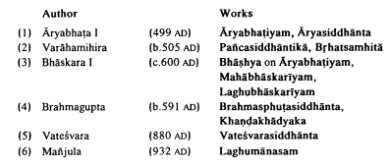
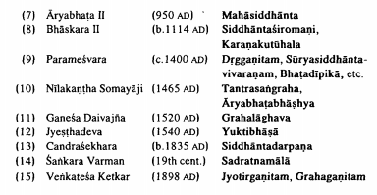
Some of the famous Indian astronomers and their works

Slide 13
CONTENTS OF A SIDDHANTA
The various topics of interest in Indian astronomy are discussed in different chapters. A chapter is called an adhyadya or adhikara. The distribution of the topics into the different adhikaras in a typical Siddhantic text is given below.
1. MADHYAMADHIKARA
The word madhyama means the average or ‘mean’ positions of planets.
2. SPASTADHIKARA
The word spasta means correct or true. In this chapter the procedure to obtain the “true” position of a planet, from the mean position, is discussed.
3. TRIPRASNADHIKARA
This chapter deals with the “three questions” of direction (dik), place(desa) and time (kala).
4. CANDRA- AND SURYA-GRAHANADHIKARA
In these chapters the computations of the lunar and the solar eclipses are discussed. The instants of the beginnings, the middle and the ends, regions of visibility, possibility of the occurrence, totality etc of the eclipses are considered.

Slide 14
CONTINUITY IN ASTRONOMICAL TRADITION
A characteristic feature of Indian astronomy Is the unbroken continuity in the tradition, beginning from the Vedic period upto recent times. Starting from simple observation and a simple calendar, there has been a gradual progress in the extent of astronomical topics, mathematical techniques, and refinement and sophistication in the computational algorithms, always aimed at greater accuracy during the Siddhantic period of evolution, spread over nearly fifteen centuries.
For example, the Aryabhatiyam carries commentaries by Bhaskara I, Paramesvara and Nilakantha Somayaji among others.
Prthudakasvamin’s commentary on the Khandakhadyaka of Brahmagupta, in addition to those by Bhattotpala and Amaraja.

Slide 15
CONTINUITY IN ASTRONOMICAL TRADITION
Bhaskara II has written his own commentary, Vasana bhashya, on his magnum opus, Siddhanta Siromani.
While Manjula (932 AD) and Sripati (c. 1000 AD) introduced additional corrections for the Moon, Nilakantha Somayaji (c.1500 CE)revised the model of planetary motion in his Tantrasangraha to obtain more precise positions of the interior planets, Budha and Sukra.
Nilakantha(c. 1500 AD) developed a heliocentric model in which all planets move around the Sun in concentric orbits. The later astronomers of Kerala, like Jyestadeva, Acyuta Pishoradi and Citrabhanu adopted this.
Candrasekhara Samanta of Orissa made additional correction to the Moon quite independently.
Kerala became the hub of tremendous development between the 14th and 19th centuries.

Slide 16
CHAPTER 2 CELESTIAL SPHERE
The stars, the planets, the Sun and the Moon are scattered through space at different and very large distances. All the same, the sky as a large hollow crystalline hemisphere with the Earth as its centre is a very convenient model for the study of the positions and motions of the celestial bodies. This hemispherical model of the sky is called the Celestial sphere. Thus, the celestial sphere is an imaginary hollow sphere of a very large radius with the Earth as its centre.

Slide 17
DIURNAL MOTION OF THE CELESTIAL BODIES
The Earth rotates about its own axis from west to east in the course of a day.
Due to this rotation of the Earth about its own axis, an observer on the surface of the Earth is carried eastward continuously.
On the other hand, the celestial sphere with all the celestial bodies, although clinging to it, appears to rotate from east to west.
This apparent westward rotation of the celestial bodies is called their diurnal motion.

Slide 18
DIURNAL MOTION BY ARYABHATA I
Aryabhata I (47 CE) the famous Indian astronomer, mentioned explicitly in his Aryabhatiyam that:
the Earth is round;
the Earth rotates about its own axis from west to east and hence all the celestial bodies appear to move in the opposite direction, from east to west, everyday.
He gives a beautiful example of this relative motion. For an observer moving in a boat on a river, all the trees, etc. on the bank of that river appear to move in the opposite direction.

Slide 19
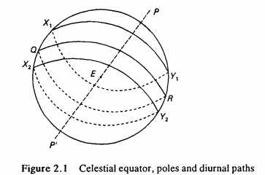
Due to the diurnal motion, the celestial bodies appear to rise in the east, move westward up in the sky and then set in the west. When the axis of the Earth’s rotation is extended, it meets the celestial sphere at two diametrically opposite points called celestial poles. The one in the direction of the Earth’s north pole is called the celestial north pole and the other pole, the celestial south pole (P and P’ in Fig. 2.1). Due to the diurnal motion, every celestial body describes a circle whose plane is perpendicular to the line PP’.
The great circle of the celestial sphere is a circle on its surface with a radius equal to that of the sphere. The great circle (QR in Fig. 2.1),whose plane is perpendicular to the line PP’ joining the celestial poles, is called the celestial equator. Thus, the diurnal paths of the celestial bodies are circles of different radii, parallel to the celestial equator. These are shown as X,Y, X,Y, etc. in Fig. 2.1.

Slide 20
MOTION OF CELESTIAL BODIES RELATIVE TO STARS
The planets, the Sun and the Moon, as observed from the Earth, move relative to the fixed stars from west to east, the direction opposite to that of the diurnal motion.
However, sometimes a planet may have “retrograde” motion (vakra gati); when it appears to move in the opposite direction, that is, from east to west relative to the fixed stars.

Slide 21
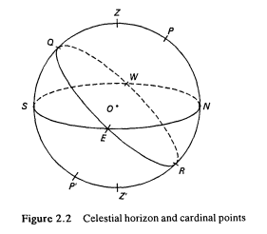
CELESTIAL HORIZON, MERIDIAN
When an observer stands at a place on the surface of the Earth and looks around describing a full circle, he finds that the sky appears to meet the Earth along a circle.
The circle, with the observer at the centre, is called the celestial horizon (Ksitija).
It is the great circle of the celestial sphere in which the tangent plane to the surface of the Earth, at the position of the observer, meets the celestial sphere. It is depicted by SENW in Fig. 2.2.

Slide 22
POLE STAR AND DIRECTIONS
The directions can be recognized with the help of the stars in the sky.
Of course, we see innumerable clusters of stars. After some time, all of them will have moved westward except one star which continues to be nearly in the same position even after a long time.
This exceptional star is called the Pole Star (or Dhruvanaksatra). Dhruva, in Sanskrit means one which is fixed or immovable.
Although the pole star is not very bright, it can be located quite effortlessly.
The direction of the pole star is very close to the north. This is so because the pole star is about 1° away from the celestial north pole.

Slide 23
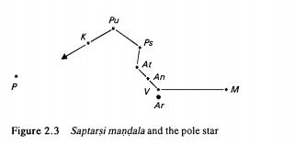
SAPTARSHI MANDALA
During the months from March to September, around 9 0’ clock in the night, one can see a group of seven stars in the shape of a hook or a question mark (?) in the northern portion of the sky, towards the northerly direction (see Fig. 2.3).
This group of seven stars, all of more or less equal brightness, is called Saptarshi mandala in Indian astronomy. This cluster of seven

Slide 24
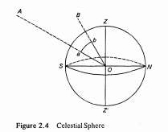
ZODIAC AND CONSTELLATIONS
Stars and planets, on a clear night, appear as luminous points set in the hemispherical dome of the sky. This imaginary sphere of an arbitrarily determined large radius is called the celestial sphere (Khagola).
This sphere has no real physical existence and, in fact, the stars and planets are at varying distances from the observer.
Since the relative angular distances of the celestial bodies are of interest in spherical astronomy, their actual linear distances are not of that much importance.
In Fig. 2.4, A and B are two celestial bodies and O is the position of the observer which is taken as the centre of the celestial sphere.

Slide 25
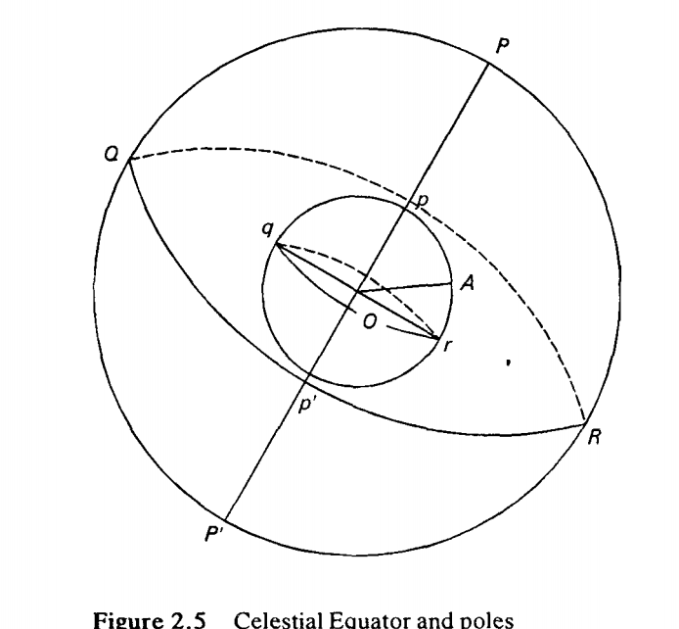
EQUATOR AND POLES (VISUVAD VRTTA AND DHRUVA)
In Fig. 2.5 The axis pp’ is extended both ways to meet the celestial sphere at P and P’, which are called the celestial north and south poles (uttara and daksina dhruva).
The great circle gr on the Earth, whose plane is perpendicular to the axis pp’ is the Earth’s equator, and the points p and p’ are the terrestrial north and south poles.
Correspondingly, the great circle QR on the celestial sphere is called the celestial equator (visuvad vrtta).
The points P and P’ are the celestial poles. It is clear that the celestial equator QR is the intersection of the celestial sphere with the plane of the Earth’s equator.

Slide 26
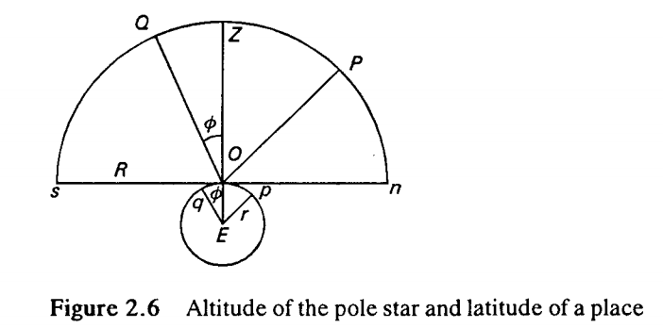
LATITUDE OF A PLACE AND ALTITUDE OF POLE STAR
The terrestrial (or geographical) latitude ∅ of a place on the surface of the Earth is the angular distance of the place from the Earth’s equator.
In other words, the latitude of a place is the angle made by the line joining the Earth’s centre to the place with the plane of the Earth’s equator.
In Fig. 2.5 (previous slide), AÔr is the latitude ∅ of the place A. The altitude of a celestial body is its angular distance from the horizon.
To put it in ordinary language, the altitude of a luminary is the angle through which the observer has to raise his eyes, above the horizon, to see the body.
In the above figure, E is the centre of the Earth and O is the position of theb observer on the Earth. The latitude ∅ of the observer O is the angle OÊq made by the line EO with the plane of the terrestrial equator Eq. In Fig.2.6, r is the radius of the Earth.

Slide 27
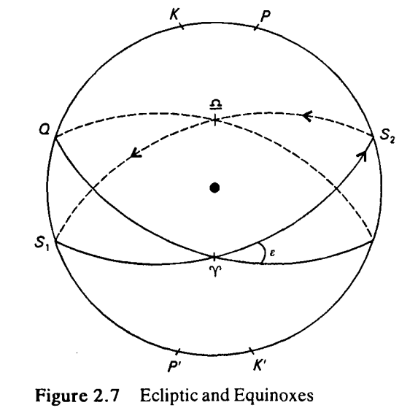
ECLIPTIC AND EQUINOXES
The apparent annual path of the Sun round the Earth, with respect to the fixed stars is a great circle S,S, (Fig. 2.7) called the ecliptic(grahanam).
The points of intersection of the ecliptic, S,S,, with the celestial equator QR are called equinoxes(vishuvam) denoted by ϒ and Ω .

Slide 28
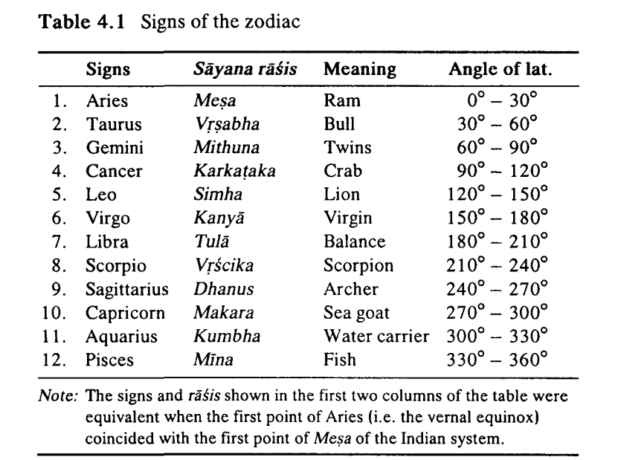
CHAPTER 3 RASI AND NAKSATRA SYSTEMS

Slide 29
ZODIAC, RASIS AND NAKSATRA SYSTEM
The zodiac is divided into 12 equal parts, each part of 30° extent ,called signs (sayana rasi).
Each sign(or sayana rasi) was once characterized by groups of stars called constellations. These are named after the objects or animals or human forms which they are supposed to resemble.
The twelve groups of stars, characterizing the twelve signs, are called zodiacal constellations. The sayana rasis have now shifted from the constellations, after which those were named, by the ‘phenomenon of precession of equinoxes’. The shift now amounts to about 23°45’.
In India, we use the unshifted nirayana rasis. The Sun moves from one sign to the next in the course of a month. It is at the first point of Aries, i.e. at the vernal equinox, around March 22nd and at the first point of Libra, i.e. at the autumnal equinox, around September 23rd each year.

Slide 30
ZODIAC, RASIS AND NAKSATRA SYSTEM
The zodiac is divided into 27 equal parts called naksatras. Each naksatra is of 13°20' (=360°/27) extent. The naksatras are calculated-from the first point of Mesa, the starting point of the zodiac in the Indian system. Thus, the twelve nirayana rasis are equivalent to the twenty-seven naksatras in the zodiac so that each rasi, in its angular extent, is equivalent to two and a quarter naksatras.
For example, the nirayana Mesa rasi constitutes two full naksatras, Asvini and Bharani, and a quarter (pada) of the naksatra, Krttika. Each naksatra is subdivided into 4 equal parts, each part being called a pada. Thus, totally 108 (27 X 4) naksatra padas constitute the zodiac.
These 108 padas are equally distributed into 12 rasis so that each rasi consists of 9 padas.
The naksatras are also called “lunar mansions” since the Moon covers these 27 naksatras in the course of a sidereal month, i.e., the time taken by the Moon to complete a revolution around the Earth with respect to the fixed stars. The average length of a sidereal month is 27.3217 days.

Slide 31
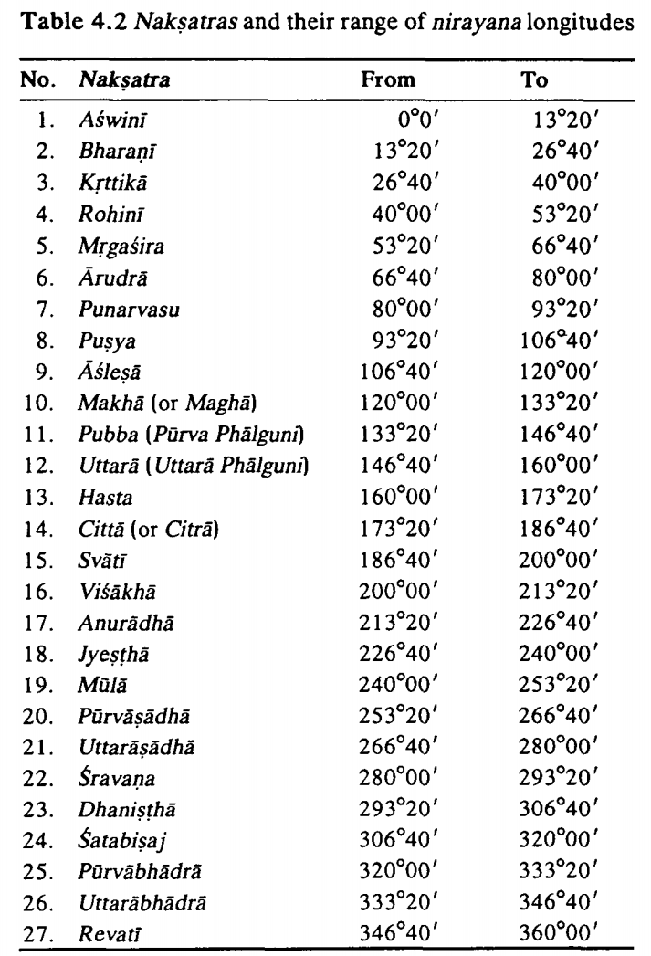
Nakshatras and their range of Nirayana longitudes

Slide 32
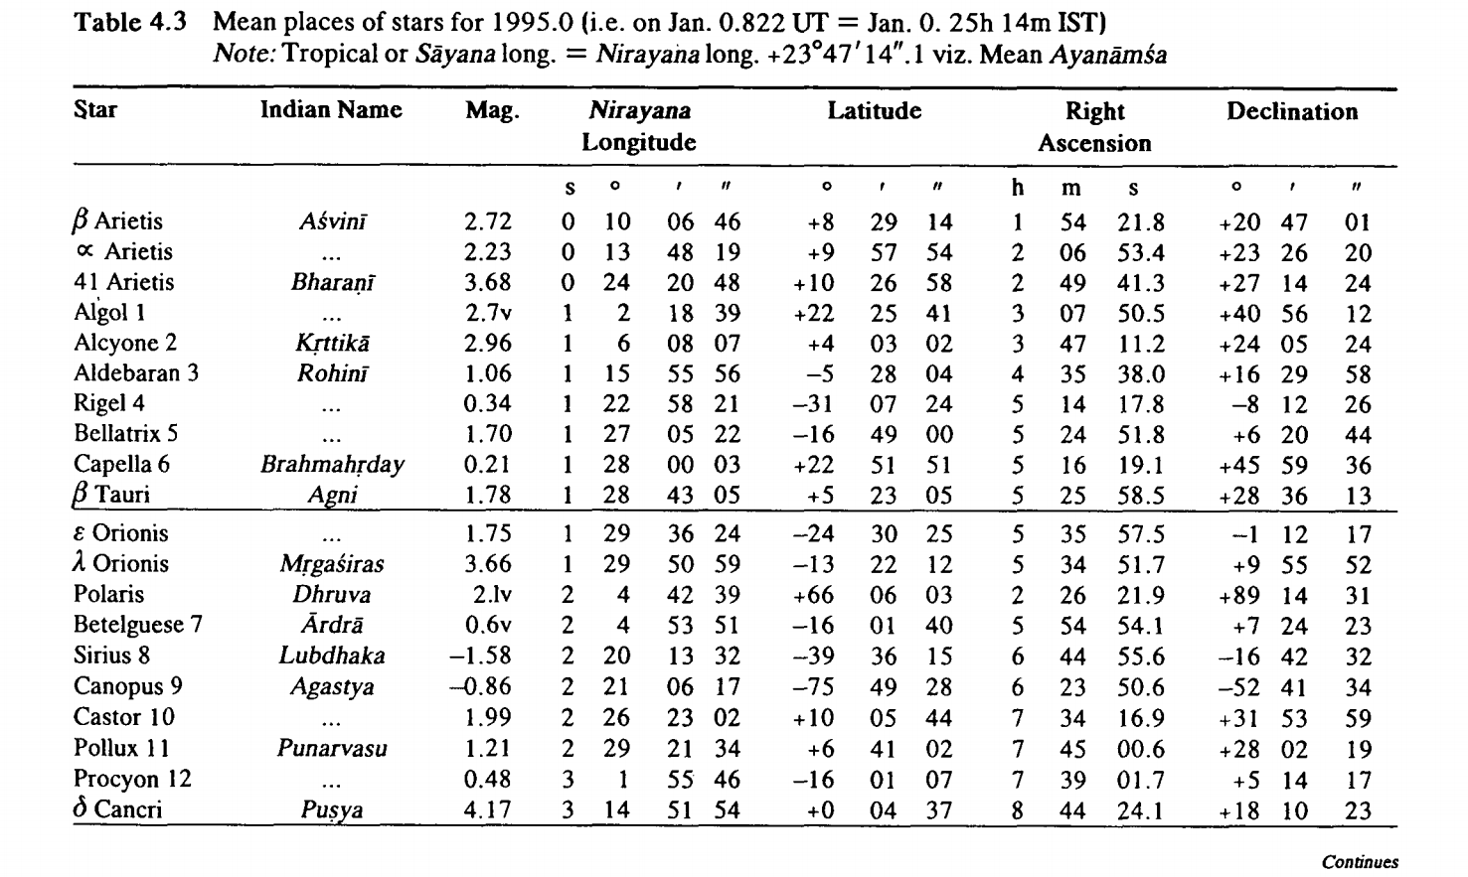

Slide 33
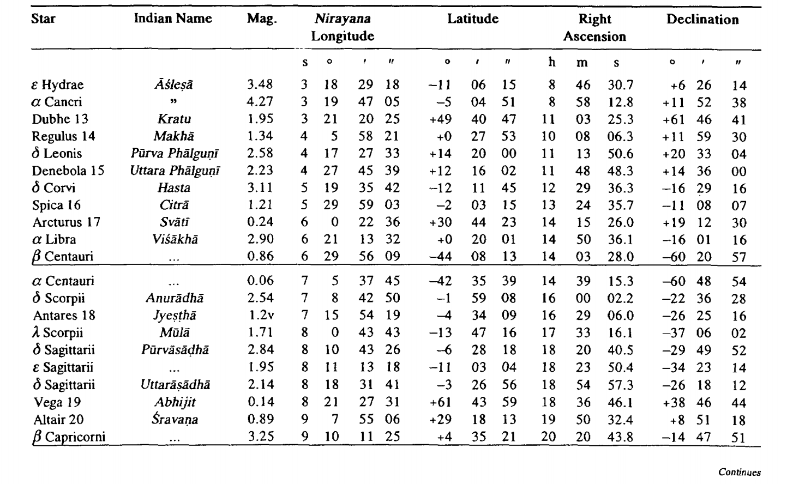

Slide 34
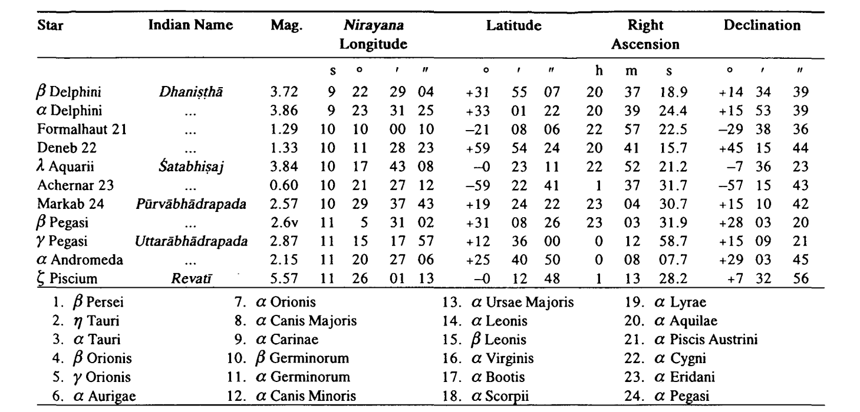

Slide 35
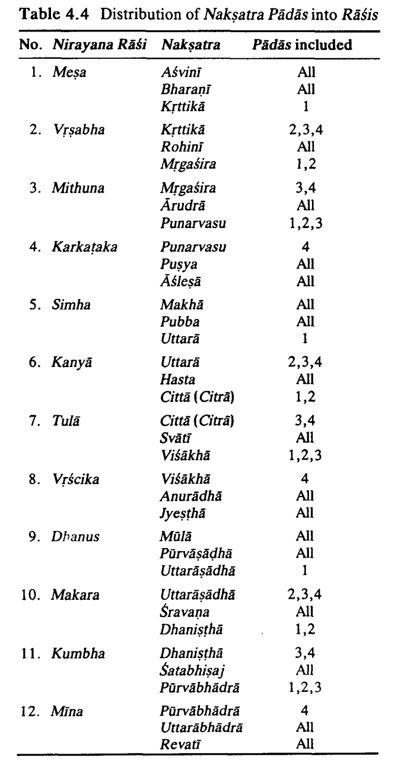

Slide 36
CHAPTER 4 TIME IN INDIAN ASTRONOMY
Time has been considered both at the microcosmic and the macrocosmic levels and explained very systematically in Indian astronomy.
On the macrocosmic scale, the yuga system is evolved as a theoretical model for describing motions of planets.
On the microcosmic scale, as small a unit of time as truti ( '1/33750 of a second) has been mentioned by Bhaskara II.
However, based on periodical natural observations such as the sunrise and sunset, new moon, full moon and seasons, a working scale of time—consisting of day, fortnight, month and year—has been used from early times.

Slide 37
CIVIL DAY (सावन-दिनम्) AND SIDEREAL DAY (नक्षत्र-दिनम्)
Due to the diurnal motion, the Sun rises in the eastern horizon, moves up in the sky westward and sets in the western horizon. Then, from the sunset to the next sunrise, it will be below the horizon during the night. The duration between two successive risings of the Sun is called a civil day (or savana dina).
Observations of sunrise over a very long time has revealed that the duration of a day is not constant but varies from day to day although slightly. This average solar day or mean solar day is referred to as a mean civil day (or madhya savana dina).
This savana dina is divided into 60 equal parts called ghatikas or 24 equal parts called hora (hours).
The time taken by the fixed stars to go around is called a sidereal day (naksatra dina); it is equal to the period of the rotation of the Earth. The word “sidereal” is used as a reference to stars.
1 civil day = 24 hours and 1 sidereal day = 23" 56" 4°.

Slide 38
SOLAR YEAR AND CIVIL CALENDAR
The time taken by the Sun to complete a revolution around the Earth, as observed from the Earth, is defined as a solar year (Varsha). But then, depending on the points of reference chosen, we have different types of solar years. Here, we consider only two types of solar years, viz. the sidereal (or nirayana) solar year and the tropical (or sayana) solar year. A sidereal solar year is the time taken by the Sun to complete a revolution with reference to a fixed star.
The duration of a sidereal year as 365.256364 days (or365 days, 6 hours, 9 minutes, 9.8 seconds). Thus, we have the equation,1 sidereal year = 365.256364 days. On the other hand, the time taken by the Sun to complete a revolution along the ecliptic with reference to the vernal equinox Y is called a tropical solar year (sayana sauravarsa). Now, 1 tropical year = 365.242190 days (or 365 days, 5 hours, 48 minutes, 46 seconds).It is the tropical year that determines seasons.

Slide 39
SOLAR YEAR AND CIVIL CALENDAR
While the Sun completes a diurnal revolution in a civil day, the fixed stars complete a little more than a full diurnal revolution in the same duration of time. After each revolution of the Sun, this extra-angular motion of the fixed stars keeps accumulating. After T mean solar days (or about 365.25 civil days), while the Sun would have made T revolutions, with reference to the fixed stars, the stars themselves will have completed (T+1), i.e., about 366.25 revolutions around the Earth. In other words, approximately, T mean solar days = (T+1) sidereal days. Therefore, approximately1 sidereal day = T/(T+1) = 365.25 / 366.25 civil day= 365.25 X 24 / (366.25) hours ie., 1 sidereal day = 23h 56m 4.1s

Slide 40
SOLAR MONTH AND LUNAR MONTH
The Sun takes about 365.25 civil days to complete one revolution. A solar month is the time taken by the Sun to cover a rasi (of 30°) along the ecliptic. Since there are 12 rasis on the ecliptic, a solar month is equal to about 365.25 / 12 days = 30.43803 days.
The Moon, like the Sun, moves from west to east with reference to the fixed stars. The motion of the Moon is much faster than that of the Sun. The Moon moves along its own orbit, inclining towards the ecliptic at an angle of about 5°8’. Since this angle is small, the Moon can be considered as moving along the ecliptic itself. It is found that the Moon takes an average period of 27.3216615 days to complete a revolution with reference to the fixed stars. This time interval is called the sidereal period of the Moon, since the Moon takes this much time.

Slide 41
SOLAR MONTH AND LUNAR MONTH
If the Sun and the Moon are moving in the same direction, in which case their celestial longitude is the same, as seen from the Earth, the Moon is said to be “new” or it is called a new moon day. After 24 hours, the Moon will have moved ahead of the Sun by about 12°10’. This separation of the Moon from the Sun goes on increasing at the rate of 12°10’ per day. When it becomes 360°, the Moon will again be in the same direction (“conjunction”) as the Sun, resulting in a new moon. It is found that the current average interval between two successive new moons is 29.530589 days (29d, 12h,44m, 2.9s).The interval between two successive new moons is called the synodic period of the Moon (“synodic” means successive conjunctions of the same bodies). This synodic period of the Moon is defined as a Lunar month (candra masa). Thus, 1 lunar month = 29.530589 days.

Slide 42
LUNI-SOLAR YEAR (OR LUNAR YEAR)
The lunar month reckoned from new moon to new moon is called amanta (or mukhyamana).
The one from full moon to another full moon is referred to as purnimanta (or gaunamana).
The lunar months are actually named after the corresponding solar months in which the initial new moon of the amanta lunar month occurs. A solar month is calculated from the entry into a rasi by the Sun (sankranti) to his entry into the next rasi
In the case of purnimanta lunar calendar, a lunar month of this system commences from the moment of the full moon exactly a paksa (fortnight) earlier than the initial new moon, from which time the amanta month of the same name commences.

Slide 43
LUNI-SOLAR YEAR (OR LUNAR YEAR)
The krsna paksa (dark half) of a lunar month is also called vadi and the sukla paksa (bright fortnight) is known as sudi.
The amanta calendar is followed for all purposes, namely, the counting of days for civil activities, festivals, religious functions, etc. in the states of Karnataka, Andhra Pradesh and Maharashtra.
The lunar (or luni-solar) year in this system commences with Caitra Sukla pratipat, following amavasya.

Slide 44
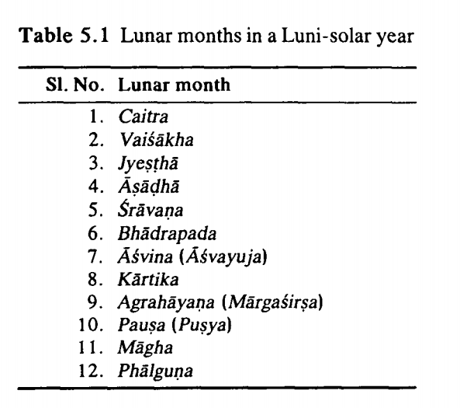

Slide 45
ADHIKAMASA and KSAYAMASA
The interval between two successive new moons or full moons, is equal to 29.530589 days. Therefore, a lunar year, consisting of 12 such lunar months, has 12 X29.530589 = 354.36706 days.
But, the mean length of a (sidereal)solar year is 365.25636 days.
The difference between a solar year and a lunar year, therefore, is obtained by 365.25636 — 354.36706 = 10.8893 days.
We found that a lunar year falls short of a solar year by about 10.8893 days. When this difference adds up to a full lunar month, an extra month (called adhikamasa) is added to that particular lunar year.

Slide 46
ADHIKAMASA and KSAYAMASA
A normal lunar year consists of 12 lunar months and a duration of 354 or 355 days. The beginning of the lunar year is at the instant of the new moon (i.e., final moment of amavasya of the previous lunar month) occurring in the course of the solar Caitra (i.e., when the Sun is in Mina ragi). This lunar month is also called Caitra.. The second month of the lunar calendar, viz. Vaisakha, starts at the following new moon and so on. (refer the fig 5.1)
In Tamil Nadu the names of the solar months are Mina or Phalguna, Mesa or Caitra, etc. But, sometimes it may happen that a lunar month falls completely within the period of the corresponding solar month. In that case, during that lunar month, there is no sankramana or entry of the Sun into the next rasi. Such a lunar month is considered as a adhikamasa (intercalary or extra month). During an adhikamasa, usually, no Hindu religious ceremony is performed. A lunar year in which there is an adhikamasa will have 13 months and 383 or 384 days. An example of the occurrence of an adhikamasa is illustrated in Fig. 5.2. This refers to the Salivahana Saka year 1913 completed (i.e., the year 1991-92 aD).

Slide 47
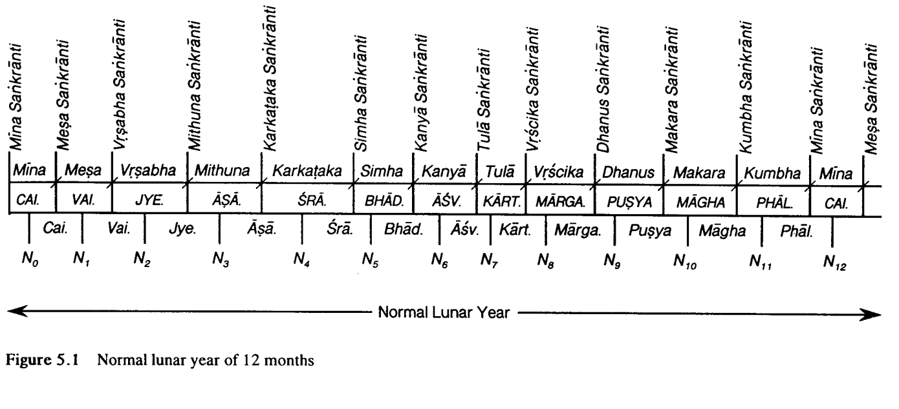

Slide 48
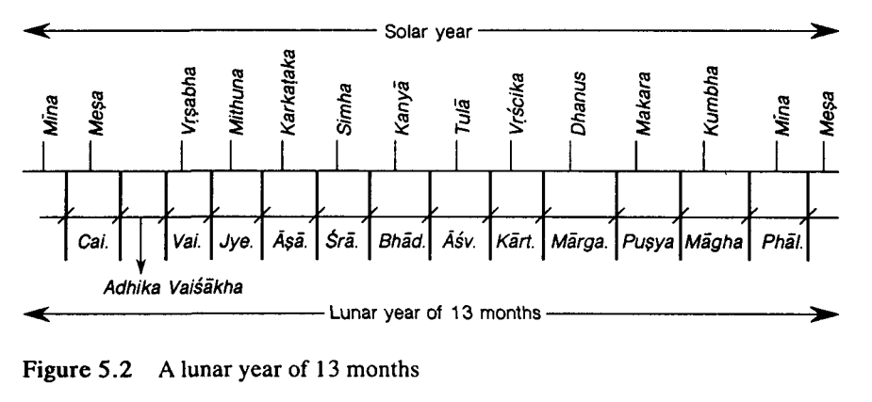

Slide 49
ADHIKAMASA and KSAYAMASA
An adhikamasa occurs after 33 months, and a particular month becomes an adhikamdsa generally once in 19 years. It is found that the lunar month of Magha never becomes an adhikamasa. Generally, an adhikamasa occurs between the months of Phalguna and Asvina.
If, in the course of a lunar month, there are two sankrantis, then that lunar month is considered as a ksayamasa (deletory month) which occurs rather rarely.
In fact, generally a ksyamasa occurs once in 141 years, although once in a way it may occur after 19 years.

Slide 50
ADHIKAMASA and KSAYAMASA
A ksayamasa occurs in one of the three lunar months — Kartika, Mrgasira or Pusya. This is so, because there is a possibility of two sankrantis in these particular lunar months due to the faster motion of the Sun during that period (the Sun will be around its perigee) and hence the solar months could be very slightly less than the corresponding lunar month.
A month which is a ksayamasa is not counted by its name at all. A lunar year in which there is a ksayamasa will have two adhikamasas, one preceding it and another succeeding it.
The interval between a new moon and the next sankranti (solar ingress into a rasi) is called a Suddhi. It is the interval gained by the candramana over the sauramana.

Slide 51
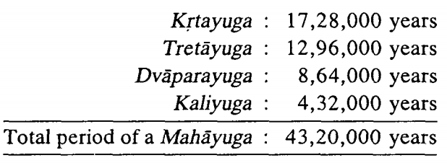
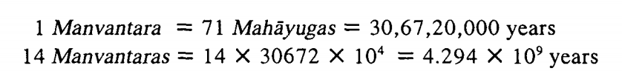
YUGA SYSTEM
While in the Vedanga jyotisa the word yuga was used to mean a period of 5 years, in later works the word meant a large period of time. So far as Indian astronomy is concerned, the yugas of large period of time have been used to indicate the rate of motion of the planets and other important points of astronomical significance.
One Mahayuga of 43,20,000 years comprises four yugas (or yugapadas), viz., Krta, Treta, Dvapara and Kali. Aryabhata took them all to be of equal duration, 10,80,000 years each. But all other astronomers, except Lalla and Vatesvara, have adopted the system of four yugas which have their durations in the ratio of 4:3:2:1.

Slide 52

Between two successive manvantaras, there is a sandhya period equal to the duration of a Krtayuga.
For the 14 manvantaras, there are 15 sandhyas (including one before the first manvantara and one after the last).
A kalpa is one thousand times a Mahayuga. A kalpa is formed by the 14 manvantaras along with their sandhyas, so that
At present, we are under Svetavaraha kalpa in which six manvantaras have already elapsed and we are now in the seventh one called Vaivasvata manvantara. In this manvantara, 27 Mahayugas have elapsed and we are now in the 28th Mahayuga. Again, in this running Mahayuga, the first three yugas, viz., Krta, Treta and Dvapara are over. The fourth, Kaliyuga, is currently running.

Slide 53
Astronomers have agreed on the point that the present Kaliyuga commenced at midnight between the 17th and 18th February 3102 BC (by the Julian reckoning).For the year 1992 AD, 5093 years have elapsed and the actual number of days (called kali ahargana) as on the midnight of January 1-2, 1992 is 18,60,158.
The Indian astronomical siddhantas assumed that at the commencement of the kalpa, all the planets including Ketu were in conjunction (i.e., at the same celestial longitude) at the first point ofAries, and the ascending node (Rahu) of the Moon was 180° away, i.e., at the first point of Libra.

Slide 54
INDIAN ERAS
An “era” is important in preparing calendars which are used for civil purposes as well as official, religious, historical and chronological records and events.
In any era that is adopted, there will be a starting point, called an epoch (yuga), from which day, for future periods, years, months and days are counted.

Slide 55
KALI ERA
The Kaliyuga is supposed to have commenced from the midnight between 17" and 18" of February, 3102 BC (Julian), the day following the midnight being a Friday.
An astronomical reference to the Kali era is available in the famous text Aryabhatiyam composed by the renowned astronomer and mathematician, Aryabhata I (476 AD). He says that he was 23 years old when 3600 years had elapsed in the Kaliyuga. That year corresponds to 499 AD, when the celebrated astronomer composed his immortal text. It has been inferred that this era was used long before Aryabhata I.
The Kali era covers the antiquity of our Indian civilization adequately which other eras cannot, since those were started later. The beginning of Kaliyuga is characterized by the end of the Mahabharata war (Aryabhata refers to the end of Dvaparayuga as Bharatãt purvam) and also the demise of Sri Krsna, according to the Puranas.

Slide 56
VIKRAMA SAKA
This era is widely used in most states of north-west India which follow the purnimanta lunar calendar. This era is used in Gujarat also.
The starting epoch of the Vikrama Saka is 58 BC, but the source of its origin is not precisely known. Popular belief is that the era was started by King Vikramaditya of Ujjayini to commemorate his victory over the Sakas or Scythians.
This era was associated with the Malavas and, hence, it was known as the Malava era for a very long time, from the early 5th century AD. Earlier it was also called the Krta era. It is also argued that this era was started by the Gupta Emperor, Candragupta II, who defeated the Sakas.

Slide 57
SALIVAHANA SAKA
This era starts from 78 AD and is very widely used for both solar and lunar calendars.
The Kusana emperor, Kanishka, the king who came after Asoka, started this era from the date of his accession, is the common belief. It is opined by some that Kanishka used the old Saka era omitting 200 years; this opinion presumes that there was a Saka era 200 years earlier. However, the date of Kanishka’s reign is quite uncertain. And, in fact, no Indian text makes any reference to support this theory.

Slide 58
KOLLAM ERA
This era is in use in Kerala and its origin is again not clear.
This era is sometimes referred to as the Parasurama era and the belief is that the Kollam era came into practice by omitting thousands of years from the earlier extant Parasurama era.
The year in the Kollam era starts from the entry of the Sun into Simha rasi; the era started from 824 AD.

Slide 59
HEJIRA ERA
The Hejira era is followed by the Muslims. The era starts from 622 AD and is based on lunar calculations.
The year begins with Muharram. This era of the Mohammedan calendar, probably introduced by the Caliph Umar about 638-39 AD, started from the evening of July 15,622 AD, Thursday (giving rise to Friday, commencing that evening)when the crescent Moon of Muharram was first visible. This was the new year day preceding the emigration of Prophet Muhammad from Mecca.
Many other eras have been in use, like Saptarsi, Yudhisthira, Buddha nirvana, Mahavira nirvana, Bengali San, Laksmanasena, Tarikh Hahi(starting from 1555 AD, introduced by King Akbar), etc.

Slide 60
TIME ON A MICROCOSMIC SCALE
In the course of a day, to fix actual muhurta (auspicious time) for rites and rituals and marriages and also for routine civil activities, smaller units of time are needed. In Indian astronomy, according to the Suryasiddhanta, the measurement of time on the micro-scale starts with prana (or asu).
The length of a prana (inhalation or exhalation) is defined as the time taken for pronouncing 10 long syllables(gurvaksara). It is also the time taken to inhale by a person in normal health.

Slide 61
TIME ON A MICROCOSMIC SCALE
The table of time-units used in the course of a day is given below:
10 guruaksara =1 prana (asu, about 4 seconds)
6 pranas = 1 vinadi
60 vinadi = 1 nadi
60 nadis = 1 day (A nadiis also referred to as a nadika or a ghatika)
There are also other units of time. In the Puranic tradition, we have
15 nimesas = 1 kastha
30 kasthas = 1 kala
30 kalas = 1 muhurta
30 muhurtas = 1 day (Here, one nimesha means ‘in the twinkling of an eye’).

Slide 62
Bhaskara II (1114 AD), in his Siddhantashiromani, provides another table:
100 thruti = 1 tatpara
30 tatparas = 1 nimesha
18 nimeshas = 1 kastha
30 kasthas = 1 kala
30 kalas = 1 ghatika
2 ghatikas = 1 ksana
30 ksanas = 1 dina
It is interesting to note that the smallest unit of time thruti, given by Bhaskara II, is 2916000000th of a day.
In terms of our modern unit of time, viz., seconds, it is 1 thruti = 1/33750 second.
Furthermore, Bhaskara II explicitly mentioned that the day taken for division into 60 ghatikas (or nadikas) is the sidereal day (naksatradina) which is of the duration of 23h, 56m, 4s and not 24 hours. Thus, a ghatika (or nadika) is a little less than 24 minutes.

Slide 63
CHAPTER 5 CALENDARS AND THE INDIAN PANCANGA
In different societies, depending on their requirements and practices - religious, social and civil as also on the levels of their computational accomplishments - different calendar systems have been evolved.
These calendar systems are essentially based on the solar year, either tropical or sidereal, or lunar (or luni-solar) year and lunations, i.e., the new moon and the full moon.
The basis of the Roman calendar — also popularly referred to as the Christian calendar — is the tropical solar year. A civil year is considered normally as consisting of 365 days(1 tropical year = 365.242190 days ). Now, in order to account for the residual part, 0.24219th day, Julius Caesar added one extra day once in four years. That year of the extra day is called a Leap year consisting of 366 days. Since a year has 12 months, the total number of days of the year are distributed among them. Some months have 30 days and the others 31 days.
Julius Caesar named a month with 31 days as July in his own honour. However, his successor, Emperor Augustus, named the month succeeding July as August, after himself, and endowed it with 31 days again. Due to this special arrangement of having 31 days in two successive months, February is impoverished and has only 28 days in the ordinary years and 29 days in leap years. This calendar is referred to as the Julian Calendar.

Slide 64
GREGORIAN CALENDAR
With the introduction of the Julian Calendar, the difference between a civil year and the natural tropical year was reduced to a great extent. But still, it amounted to an excess of 0.00781st of a day (i-e., 11 minutes, 15 seconds) over the tropical year. In the course of a 100 years, this difference accumulates to 0.781st of a day.
The religious head of the Roman Catholic Church as that time, Pope Gregory XII (1572-1585 ad), introduced a further change in the Roman Calendar to compensate for this excess. By the latter part of the 16th century, the excess in the civil year had accumulated to about 10 days.

Slide 65
GREGORIAN CALENDAR
The following changes were introduced in the new style (N.S.)calendar, now popularly called the Gregorian Calendar, with effect from 1582 AD:
1) The day succeeding October 4, 1582, Thursday, would be considered as October 15, 1582, Friday. In other words, October 5 was changed to October 15, thus shedding the extra 10 days.
2) As in the Julian Calendar, there would be a leap year once in 4 years; in the leap year, an extra day is added to February. Ordinarily, if a year of the Christian era is divisible by 4, then that year is a leap-year with some exceptions.
3) The century years, viz., 1600,1700, etc., will be leap-years only if they are divisible by 400 (and not just by 4). Thus, while 1600 AD and 2000 AD are leap-years, the century years, 1700, 1800 and 1900 AD are not leap-years.
After the introduction of the Gregorian Calendar, the difference between a civil year and a tropical solar year was reduced to just about 0.1216" of a day (i.e., 2 hours, 55 minutes, 6 seconds) in the course of 400 years.

Slide 66
HINDU CALENDAR
The Indian calendar has evolved over thousands of years since the Vedic times and has continuously undergone refinements. There are essentially two systems followed in the Indian calendar, viz. Luni-solar and purely solar.
LUNI-SOLAR CALENDAR
Each lunar year is called a samvatsara. A cycle of 60 samvatsaras is followed. This cycle is five times the Jovian cycle (or Barhaspatya cycle) of 12 years. The names of the sixty samvatsaras are given in the Table 6.1.
The lunar new year commences with the Candramana Yugadi, the first day of the (amanta) Chaitra which follows the new moon just preceding the Mesa sankramana (i.e., before about April 14).
For example, in 1993, the Candramana Yugadi falls on’ March 24,Wednesday, when the lunar new year commences. This first day of the Caitra month immediately follows the new moon preceding Sankranti which falls on April 13, 1993. In fact, this lunar year(1993-94) corresponds to the Srimukha samvatsara and Salivahana Saka year 1915 elapsed. In the Kaliera, the new lunar year corresponds to the year 5094 elapsed.

Slide 67
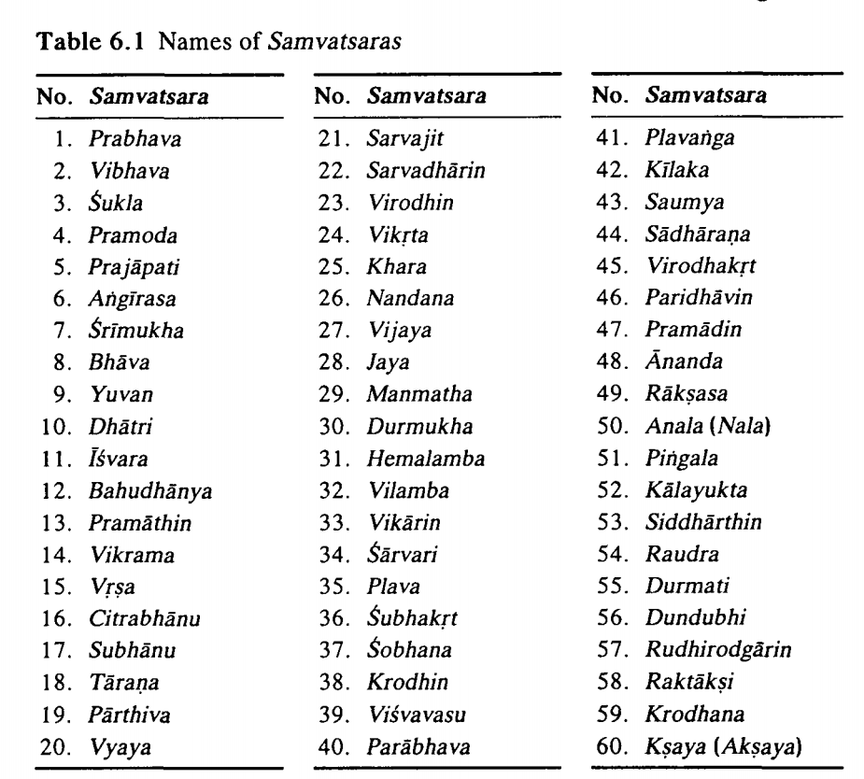
NAMES OF SAMVATSARAS

Slide 68
SOLAR CALENDAR
Among the Hindus, a purely solar calendar is also used. The solar year starts when the Sun enters the constellation Mesa, i.e., with the Mesa sankramana (or solar ingress into Mesa). In the current period it is around April 14 (or13 or 15).
The solar year is divided into 12 solar months. The length of any particular solar month is the duration of the stay of the Sun in that particular rasi (of 30° extent) of the zodiac. Some solar months are longer and some shorter, since the Sun moves faster near its perigee and slower near the apogee.
The solar months are named after the rasis the Sun occupies during these months, as Mesa, Vrsabha, etc. But, more popularly, the names of the solar months are the same as those of the lunar months, viz.,Caitra, Vaisakha, etc. These names are prefixed as “saura” to distinguish them from the lunar.
The solar year commences with saura Vaisakha around April 14 and ends with saura Caitra. The names of the solar months are ambiguous, followed differently in the different regions of India. Therefore, it is better to name them after rasis occupied by the Sun.

Slide 69
HINDU FESTIVALS
Most of the Hindu festivals are based on the luni-solar (or lunar)calendar. Each of these falls on a particular tithi of a specified paksha in a particular lunar month. The lunar new year’s day is called Chandramana Yugadi, falls on Shukla pratipaat of the (amanta) Chaitra month.
SRIRAMANAVAMI is celebrated eight days later, i.e., on Shukla navami of the same Chaitra month.
SRI KRSNA JANMASTAMI falls on ashtami of the krshna paksha in the month of (amanta) lunar Sravana.
GANESA CATURTHI when Lord Ganesha is worshipped coincides with Shukla chaturthi of the Bhadrapada month.
MAHALAYAAMAVASYA falls on (amanta) Bhadrapada amavasya, i.e., on the last of the month in which Ganesa chaturthi falls.

Slide 70
DASARA is celebrated ten days following the Mahalaya amavasya from Asvayuja Sukla pratipat to dasami. In Bengal this period is celebrated as DURGA PUJA. The DASARA procession of Mysore celebrating the slaying of Mahisasura by the goddess Camundesvari is very famous. The tenth day of the DASARA period is celebrated as VJAYADASAMI. In North India it is observed as RAMLILA to celebrate Sri Rama’s killing Ravana. On this occasion, huge figures of Ravana, Kumbhakarna and Meghanada are erected in public places and then set on fire using fire-works to symbolize the destruction of evil and the triumph of the good.
DIWALI (or DEEPAVALI) is a major festival celebrated throughout the country. Generally this festival is held for two days Naraka caturdasi and Dipavali (amavasya) on the following day, which fall on (amanta) Asvayuja krsna caturdasi and amavasya. DIWALI is popularly known as the festival of lights.
MAHASIVARATRI is an important day observed by Saivites, which falls on amanta Magha krshna chaturdashi.

Slide 71
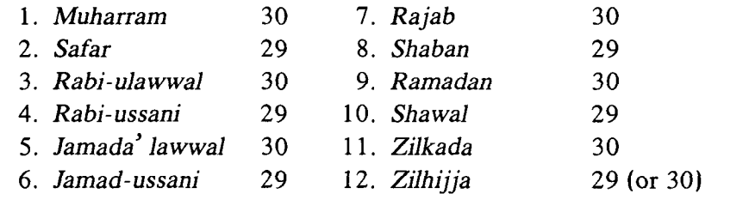
ISLAMIC CALENDAR
The Islamic (or Mohammedan) calendar is purely lunar.
The beginning of each month is determined by the observation of the crescent moon in the evening sky. Therefore, in an Islamic year of 354 (or 355) days, each month has 29 or 30 days.
The era of the Islamic calendar viz., the Hejira(A.H.) started from the evening of July 15, 622 AD when the crescent moon (following the new moon) of the first month, Muharram, was first visible. This was the new year day before the emigration of Prophet Muhammad from Mecca which was on September 20, 622 AD.
The leap-year, in which the last month Zilhijja has one day more(i.e., 30 days), contains 355 days and is known as Kabishah. In a cycle of 30 years, there are 19 common years of 354 days and 11 leap-years of 355 days.
The rule for determining a leap-year is as follows: if after dividing the Hejira year by 30, the remainder is 2,5,7,10,13,16,18,21,24,26 or 29, then it is a leap-year. The twelve lunar months of the Islamic calendar and their fixed number of days are listed below:

Slide 72
THE INDIAN CALENDAR AND PANCANGA
A lunar year consisting of about 354 days is pegged on to the solar year of about 365 days, by introducing the adhikamasas (intercalary months)in a natural way based on the absence of a Sankranti in a lunar month.
Then a lunar month, during which there are waxing and waning phases of the Moon, is divided into two equal halves called shukla paksha and krshna paksha.
During the shukla paksha (bright half), the phases of the Moon increase from new to full through the crescent, half and gibbous phases.
In the krshna paksha (dark half), the Moon wanes from full to new in the reverse order.
In a paksha, there are 15 days.
Each vara(week) has 7 days which are named as Ravivara, Somavara, etc. after the planets. The year in a calendar is identified by the number of years elapsed since the beginning of the ongoing era like Kali or Saka.

Slide 73
WHAT IS THE PANChANGA?
In a traditional Hindu household the annual panchanga is indispensable.
A Hindu uses the panchanga for all his religious observances and also for ascertaining the dates of important religious festivals like Ganesa Caturthi, Sri Ramanavami, Sri Krsna Astami, Yugadi as well as special days like Ekadashi, Dvadashi, Amavasya and Purnima.
As the word indicates, the panchanga consists of five parts
Tithi
Naksatra
Vara
Yoga and
Karana.
In addition to the details about the above five parts, the panchanga also contains a good deal of information which is of relevance in astrological, religious, social fields and also for predicting planetary positions, sunrise and sunset timings.

Slide 74
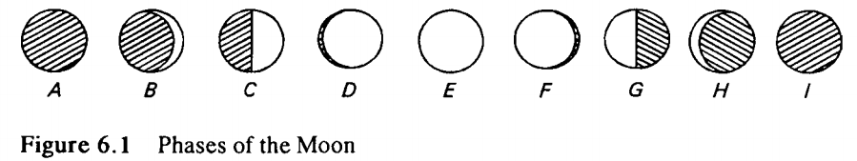
TITHI
In the course of a lunar month, from a new moon to the next new moon, the shape and size of the Moon changes from day to day.
On an amavasya day (new moon day) the Moon is invisible as in A, (see Fig.6.1). On the next day, a very thin “crescent” moon B is visible, if the sky is clear, soon after the sunset in the western horizon.
On the succeeding days of the shukla paksha the brighter or visible part of the Moon keeps on growing until it is half (C) on the 7" or 8" day after the new moon.

Slide 75
TITHI
Also, each day, the Moon keeps moving up in the sky at sunset since it moves farther from the Sun at the rate of about 12° per day. When the phase of the Moon is half, it will be mid way in the sky between the eastern and the western horizons. Then, each succeeding day the brighter part of the Moon grows more than half when it is said to be gibbous, D. At the end of the Shukla paksha, the Moon will be fully visible, E, when the krshna paksha (dark half of the month) commences.
In the krshna paksha, the phases of the Moon diminish (or wane) in the reverse order. From the full moon upto the 7" or 8" day more than half the Moon is bright when it is said to be gibbous, F. Then, on sapthami or ashtami, the Moon will be half(G). The bright portion of the Moon goes on decreasing till it is crescent (H) again, a day before the new moon day. At the end of the krshna paksha the Moon is totally invisible on the new moon day, I.

Slide 76
The lunar month is divided into 30 parts called tithis.
The bright half has 15 tithis and so too the dark half.
The duration of a tithi is the time taken by the Moon to move 12° relative to the Sun. The durations of different tithis are not equal.
In a paksa (fortnight), starting from the new moon or the full moon, there are 15 tithis:
Pratipaat | 2. Dvitiya
3. Tritiya | 4. Chaturthi
5. Panchami | 6. Shashti
7. Saptami | 8. Ashtami
9. Navami | 10. Dashami
11. Ekadashi | 12. Dvaadashi
13. Trayodashi | 14. Chaturdashi
15. Amavasya/ Pounami

Slide 77
NAKShATRA
The naksatra at a given time, on a given day, is the “asterism”, one of the 27 divisions of the zodiac, from Asvini to Revati.
The extent of a naksatra is 13°20' = 360°/27, and hence the running naksatra is obtained by dividing the nirayana longitude of the Moon M by 13°20’ (i.e., by 13.3333°).
Thus, Naksatra = (Longitude of the Moon in degrees) / 13°.3333M/13.33333°

Slide 78
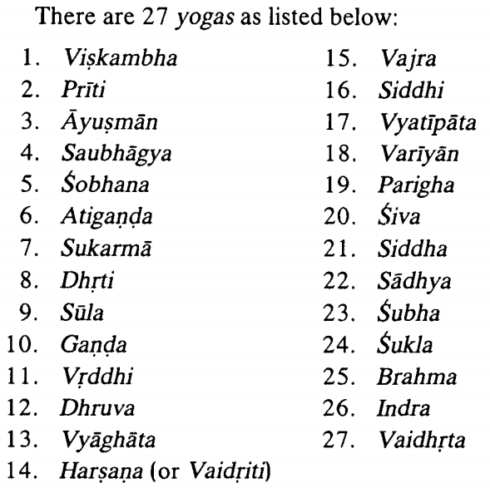
YOGA
The sum of the nirayana longitudes of the Sun and the Moon is divided into 27 equal divisions called yogas.
The sum of the nirayana longitudes of the Sun and the Moon is converted into minutes and then divided by 800. The quotient represents the number of yogas completed and, hence, the current running yoga is obtained by adding 1 to the completed number of yogas.

Slide 79
KARANA
There are 11 karanas of which 4 are immovable and 7 are movable.
The names of the karanas are as follows:
Cara (movable) karanas: Bava, Balava, Kaulava, Taitila, Gara, Vanij, Visti.
Sthira (immovable) karanas: Sakuni, Catuspada, Naga and Kimstughna.
In each tithi, the first half is one karana and the second half is the next karana, so that each karana is situated at 6° of the angular distance between the Sun and the Moon.
In the particular four half- tithis, viz.,the second half of krsna paksa (i.e. Bahula), Caturdasi, the two halves of Amavasya and the first half of the Pratipat are the sthira karanas,viz., Sakuni, Catuspada, Naga and Kimstughna respectively. Then, fromthe second half of the pratipat of sukla paksa, we have the cara karanas, viz., Bava, etc., repeating the cycle of 7 karanas, eight times.

Slide 80
VARA
The remainder of the pancanga is vara or vasara, ie., the week day. A seven-day week is followed.
The week days are Ravivara, Somavara, Mangalavara, Budhavara, Guruvara, Sukravara and Sanivara which correspond to Sunday, Monday, Tuesday, Wednesday, Thursday, Friday and Saturday.
The seven days of the week are named after the seven luminaries: the Sun, Moon, Mars, Mercury, Jupiter, Venus and Saturn.
This order has been obtained as follows. Arrange the 7 bodies in the decreasing order of their periods as Saturn, Jupiter, Mars, Sun, Venus, Mercury, Moon. Divide the day into 24 hours and assume that these bodies are the rulers of successive hours in cyclic order. Then the day is named after the ruler of the first hour. If we start from Saturn as the ruler of the 1st hour, it will again be the ruler of the 22nd hour. Then the 23rd hour will belong to Jupiter, 24th to Mars and 25th i.e., the 1 hour of the next day to the Sun, and so on.

Slide 81
Thank you. This presentation intended to cover the following: the Vedangas the Siddhantas about the Astronomers the Celestial Sphere Rasis and Nakshatra systems Time calculations in Indian astronomy that included the Yuga and Eras Calendars of various faiths and the Indian Pancanga

